Slide 1
Lecture 24: Intermolecular forces
California State University, Fullerton
2023 Fall Semester – Chem 123

Slide 2

QUESTIONS, COMMENTS, AND CONCERNS?

Slide 3
Outline
Announcements
Highlights prior lecture:
Intermolecular Forces – Connection to Real World
Phase Changes and Heating Curves
Vapor Pressure, Viscosity, Freezing/Boiling Point, and Surface Tension
Summary of the Research Article
Ch. 12: Liquids and Solids
Phase Diagrams
Types of Solids
Ch 13: Solutions
Concentration Units – Mass Percent, Mole Fraction, and Molality
Colligative properties

Slide 4
announcements
Final Exam on Dec 11th at 5:00pm – 6:50pm in MH 121
Cumulative – 50% covering new materials and 50% covering old materials
6 – 8 questions
EC opportunity up to 10 pts towards homework assignment grade
Online Homework Ch 12 due Tues, Dec 5th at 11:59pm
For final exam, opportunity to replace lowest score between exam 2 and exam 3
Posting the solutions to the exams 1-3 by end of Tues, Dec 5th

Slide 5
Outline
Announcements
Highlights prior lecture:
Intermolecular Forces – Connection to Real World
Phase Changes and Heating Curves
Vapor Pressure, Viscosity, Freezing/Boiling Point, and Surface Tension
Summary of the Research Article
Ch. 12: Liquids and Solids
Phase Diagrams
Types of Solids
Ch 13: Solutions
Concentration Units – Mass Percent, Mole Fraction, and Molality
Colligative properties

Slide 6
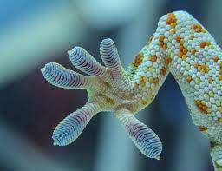
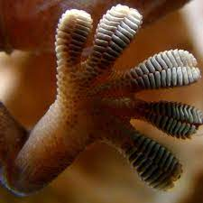
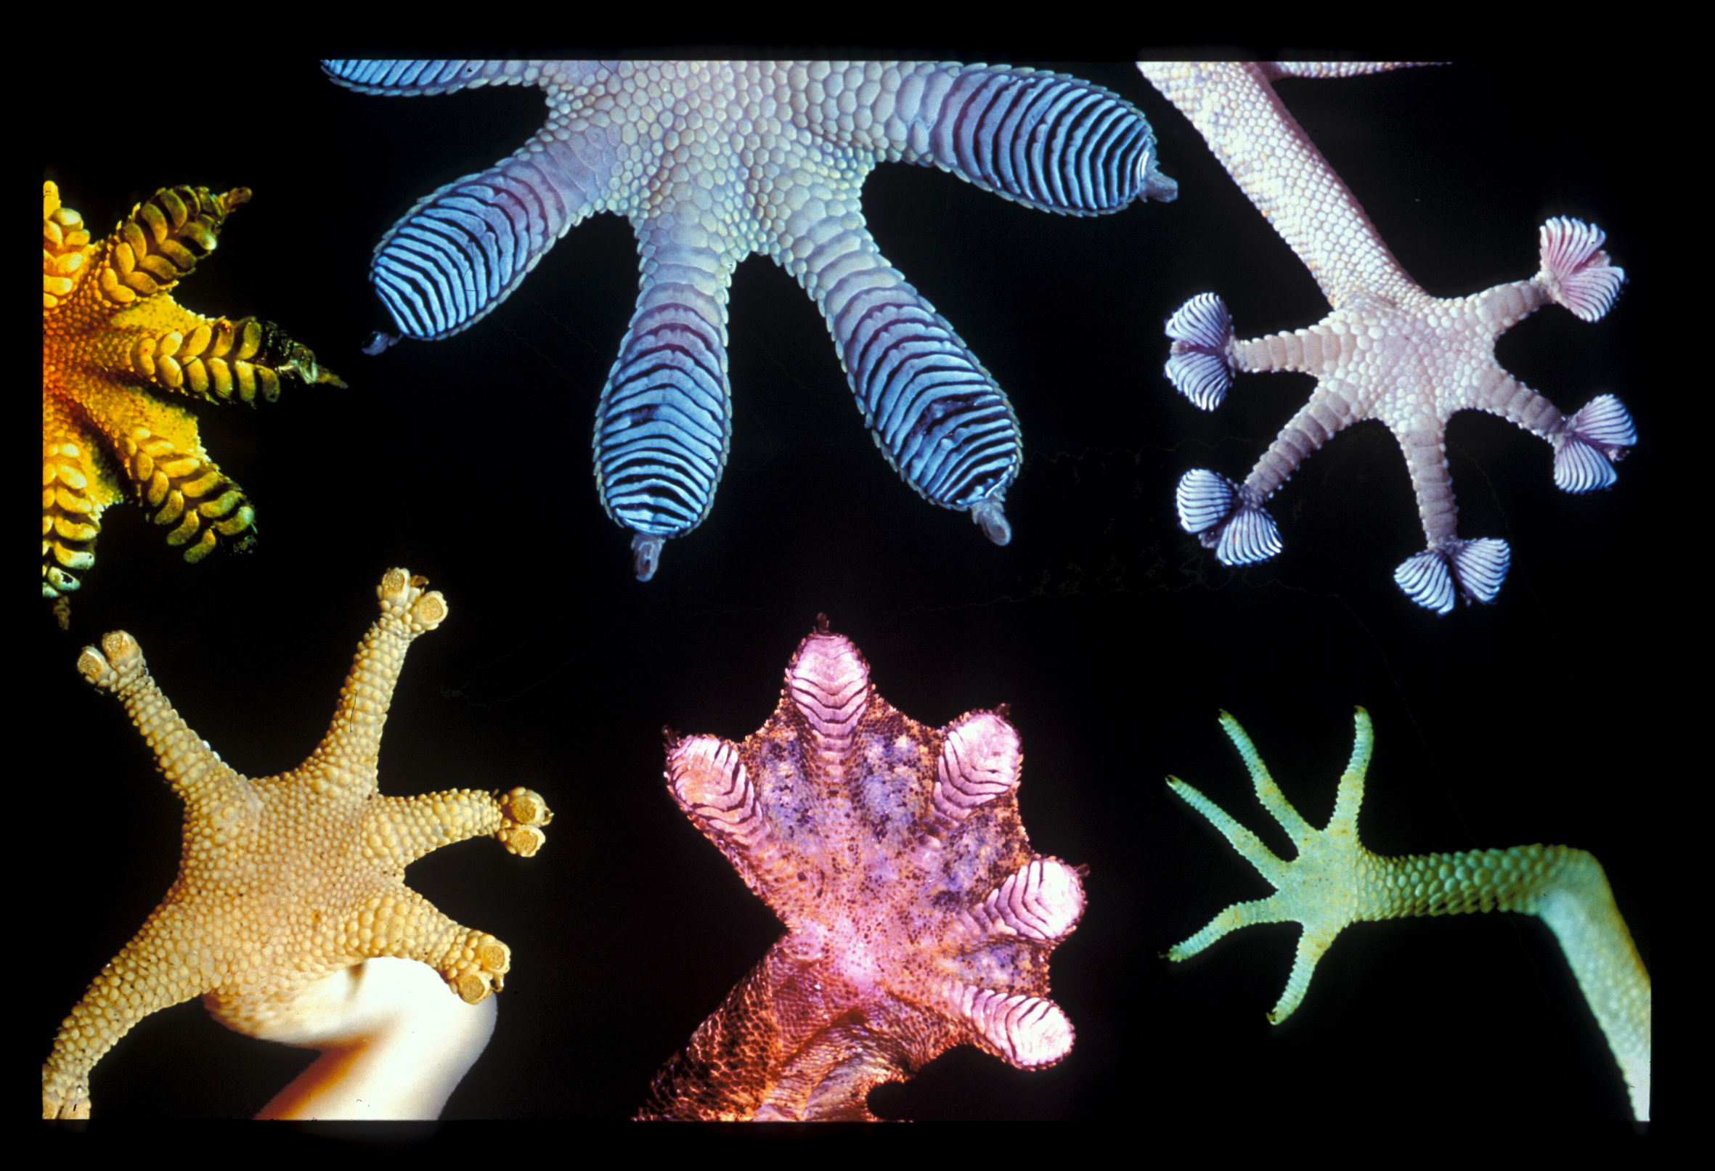
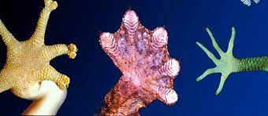
Real world connection: intermolecular forces
Gecko's Feet

Slide 7
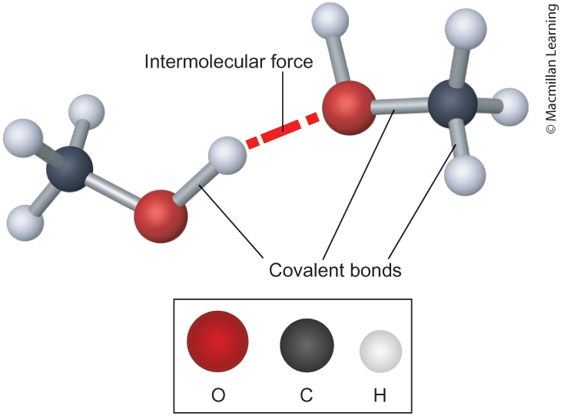
Intermolecular forces
Intramolecular interactions – interactions within the molecule
Intermolecular interactions – Interactions between molecules
Play an important role determine relative freezing/boiling points, viscosity, vapor pressure, and surface tension

Slide 8
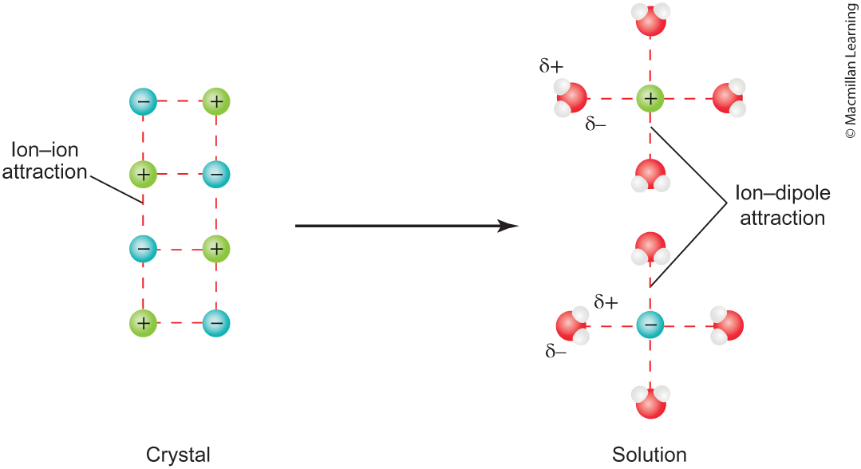
Types of Intermolecular forces: Ion-Dipole (strongest)

Slide 9
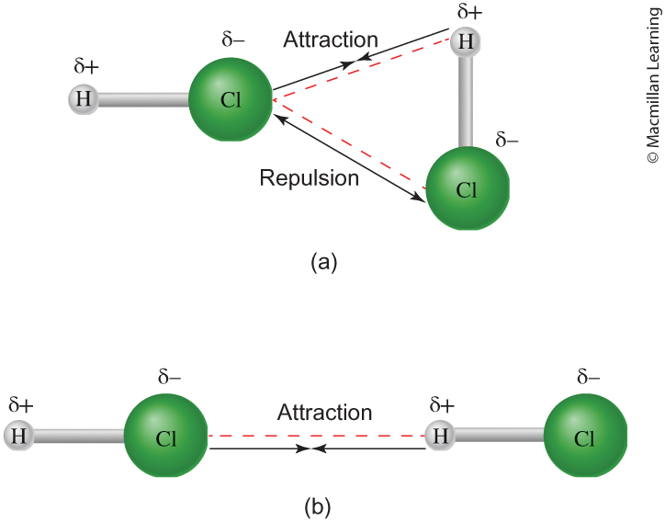
Types of Intermolecular forces: Dipole-Dipole

Slide 10
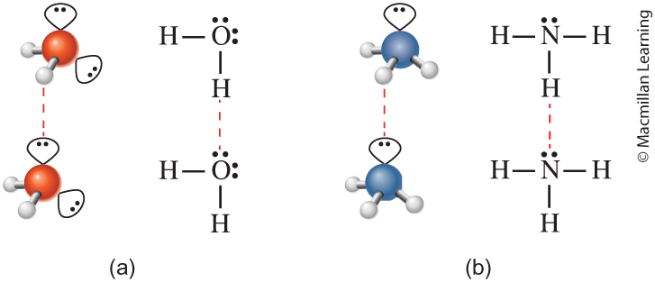
Type of intermolecular forces: Hydrogen bonding
A stronger type of dipole-dipole interaction, only applicable when H atom is attached to N, O, and F (due to high electronegativity)
Water (H₂O) has 2 hydrogen donors and 2 lone pairs
Ammonia (NH₃) has 3 hydrogen donors but only 1 lone pairs

Slide 11

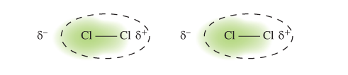
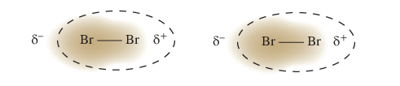
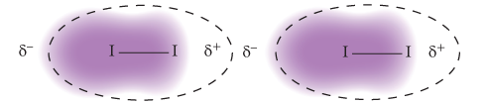
Type of intermolecular forces: Dispersion (weakest)
Universal and present in all molecules
Textbook definition – instantaneous dipole moments
Strength of dispersion grows with the size of the molecule

Slide 12
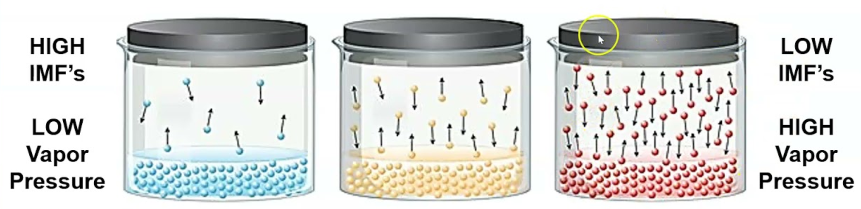
Vapor pressure and intermolecular forces
Stronger intermolecular forces lead to lower vapor pressure
Vapor pressure – vapor present above the liquid surface (exists an equilibrium between the liquid and gas phase of the compound

Slide 13
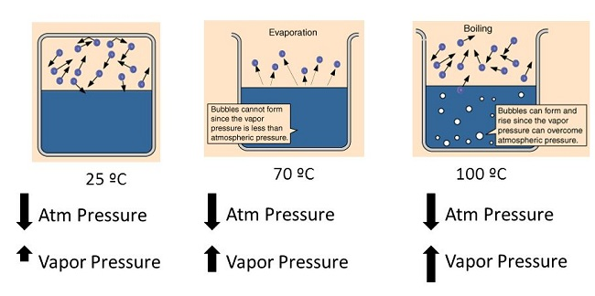
Vapor pressure and boiling point
Liquids boil when the vapor pressure is equal to the atmospheric pressure (1 atm or 760 mm Hg)
Liquid has a high vapor pressure at room temperature – lower boiling point

Slide 14
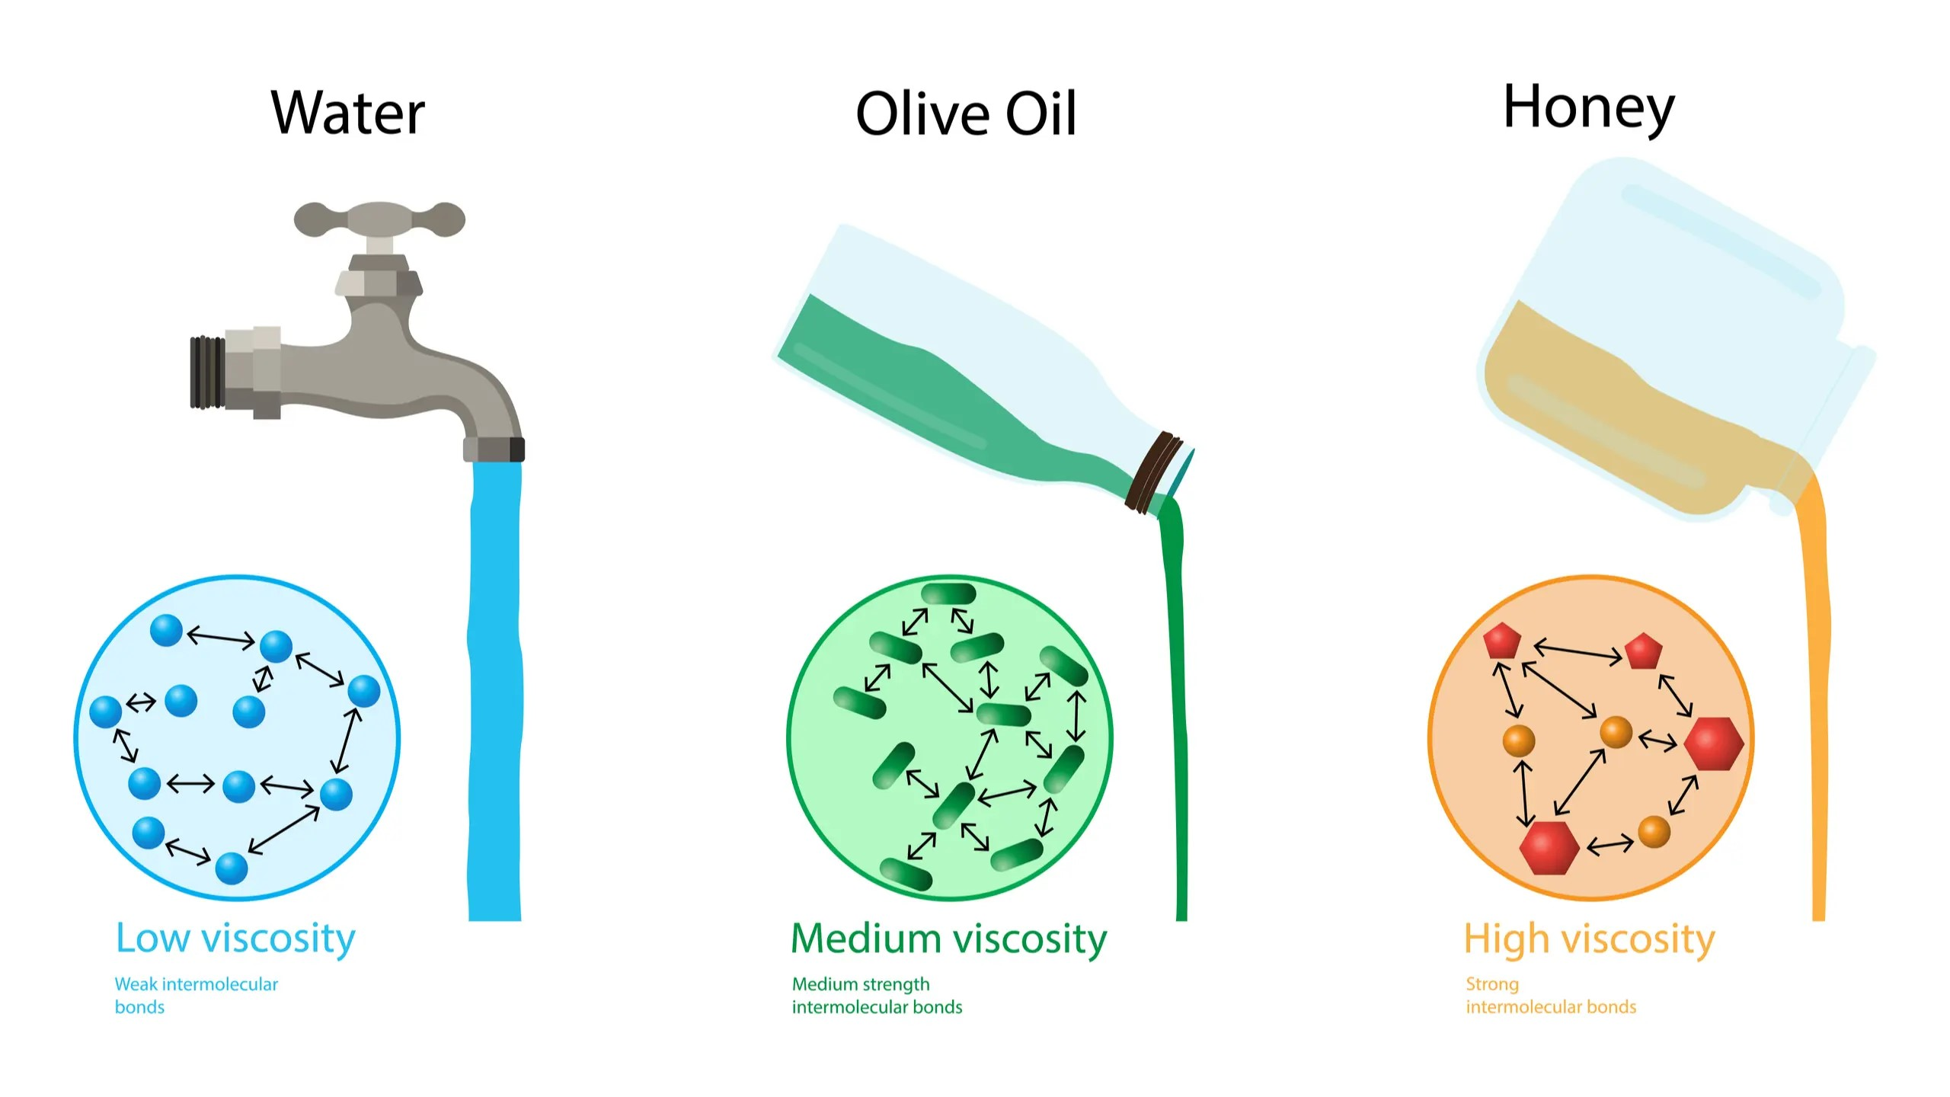
Viscosity and intermolecular forces

Slide 15
Q: Rank the compounds from lowest to highest vapor pressure and Lowest to highest boiling point.
Hint: list out all possible intermolecular forces
H₂O
NH₃
C₁₀H₂₂ (Decane)
CH₄
H₂SO₄

Slide 16
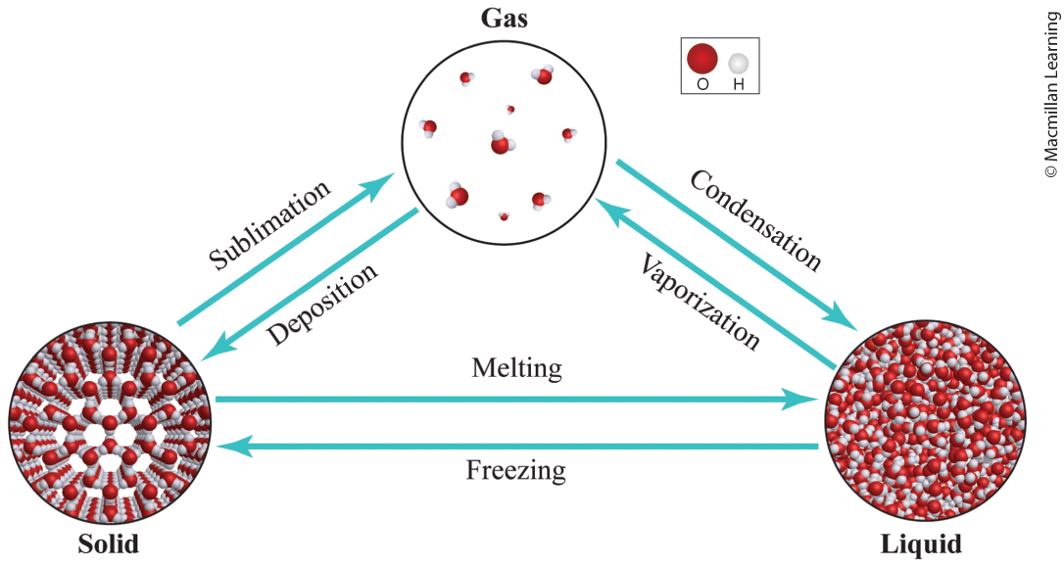
Phase changes
ΔHfus - enthalpy of fusion is energy refer to changes between solid and liquid (kJ/mol)
ΔHvap - enthalpy of vaporization is energy refer to changes between liquid and gas (kJ/mol)
ΔHsub - enthalpy of sublimation is energy refer to changes between solid and gas (kJ/mol)

Slide 17
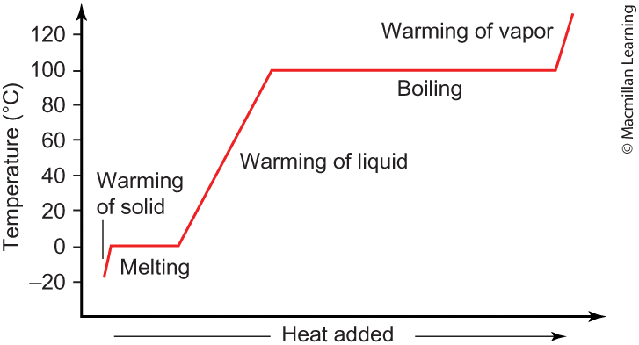
Calculation amount of heat for phase changes
Heating up materials (solid, liquid, and vapor) use q = mCΔT
Enthalpy of fusion, vaporization, and sublimation (pay attention to kJ/mol or kJ/g)

Slide 18
Example: calculate the amount of energy required to heat 50.0g ice from –20°C to water vapor 120°C
Specific heat for water is 4.187 J/(g C), for ice 2.108 J/(g K), and for water vapor (steam) 1.996 J/(g C)
ΔHfus = 334 J/g and ΔHvap = 2,260 J/g

Slide 19
Outline
Announcements
Highlights prior lecture:
Intermolecular Forces – Connection to Real World
Phase Changes and Heating Curves
Vapor Pressure, Viscosity, Freezing/Boiling Point, and Surface Tension
Summary of the Research Article
Ch. 12: Liquids and Solids
Phase Diagrams
Types of Solids
Ch 13: Solutions
Concentration Units – Mass Percent, Mole Fraction, and Molality
Colligative properties

Slide 20
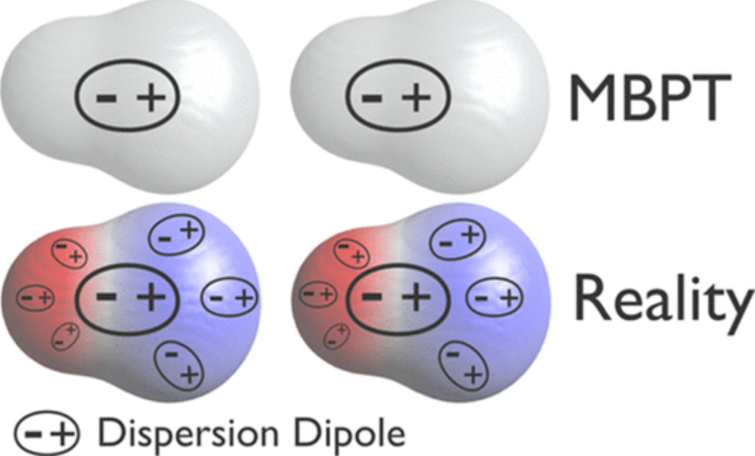
Divergence of Many body perturbation theory
Textbook definition – instantaneous dipole moments
Research perspective – dispersion dipoles and electronic screening (intra- and interscreening)

Slide 21
Outline
Announcements
Highlights prior lecture:
Intermolecular Forces – Connection to Real World
Phase Changes and Heating Curves
Vapor Pressure, Viscosity, Freezing/Boiling Point, and Surface Tension
Summary of the Research Article
Ch. 12: Liquids and Solids
Phase Diagrams
Types of Solids

Slide 22
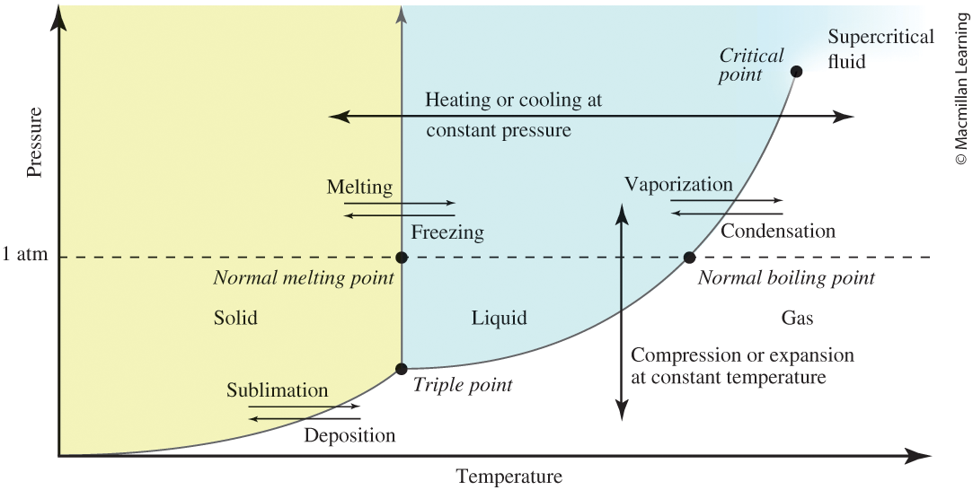
Phase diagrams
Phase diagrams – shows the phases that the substance exists at specific pressure and temperature (Generic diagram above)

Slide 23
Phase diagrams
Line separating the two phases such as liquid-gas, liquid-solid, and solid-gas indicates an equilibrium between the two phases
Triple point – where all three phases exists (solid, liquid, and gas); water example https://www.youtube.com/watch?v=Juz9pVVsmQQ
Critical point – where the substance is neither a liquid or gas also known as supercritical fluid; CO₂ example https://www.youtube.com/watch?v=bJjcTpRzXpM

Slide 24
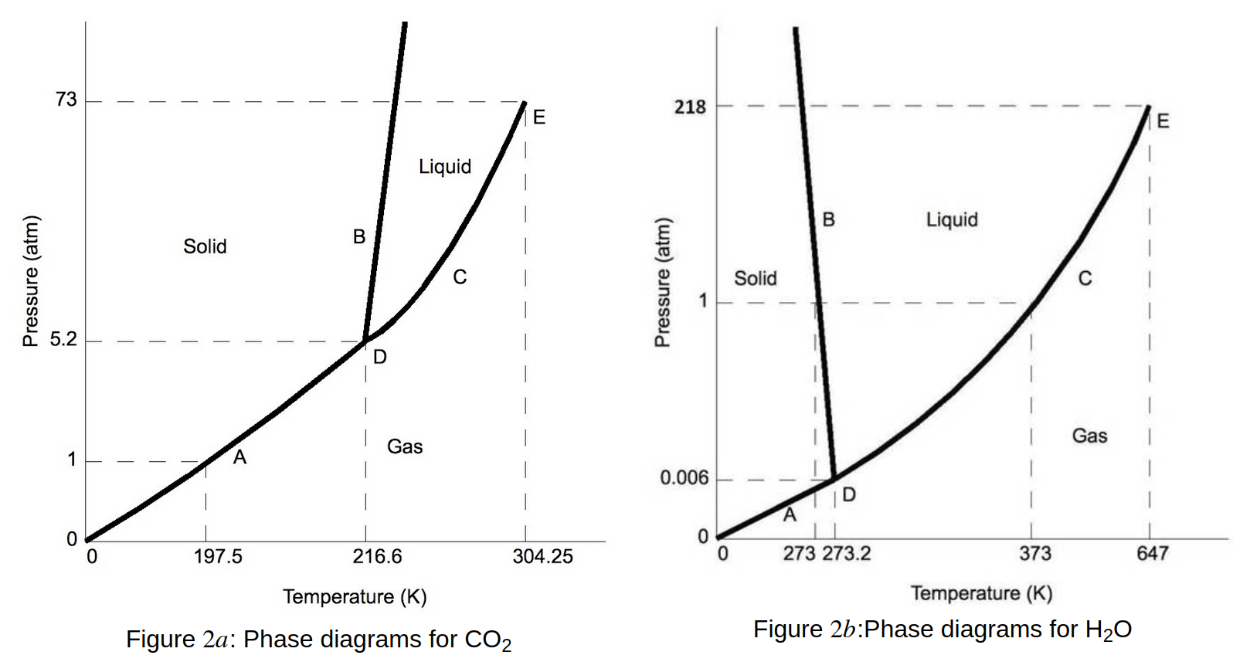
Phase diagram: CO₂ and H₂O

Slide 25
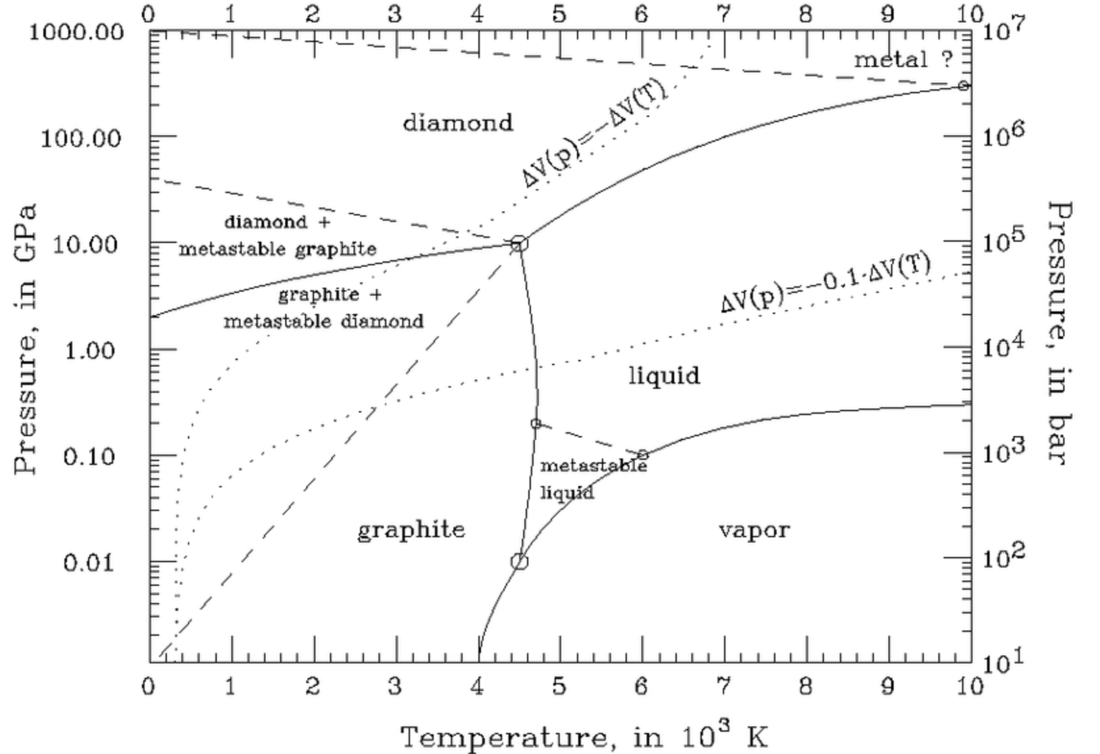
Phase diagram: Carbon

Slide 26
Outline
Announcements
Highlights prior lecture:
Intermolecular Forces – Connection to Real World
Phase Changes and Heating Curves
Vapor Pressure, Viscosity, Freezing/Boiling Point, and Surface Tension
Summary of the Research Article
Ch. 12: Liquids and Solids
Phase Diagrams
Types of Solids
Ch 13: Solutions
Concentration Units – Mass Percent, Mole Fraction, and Molality
Colligative properties

Slide 27
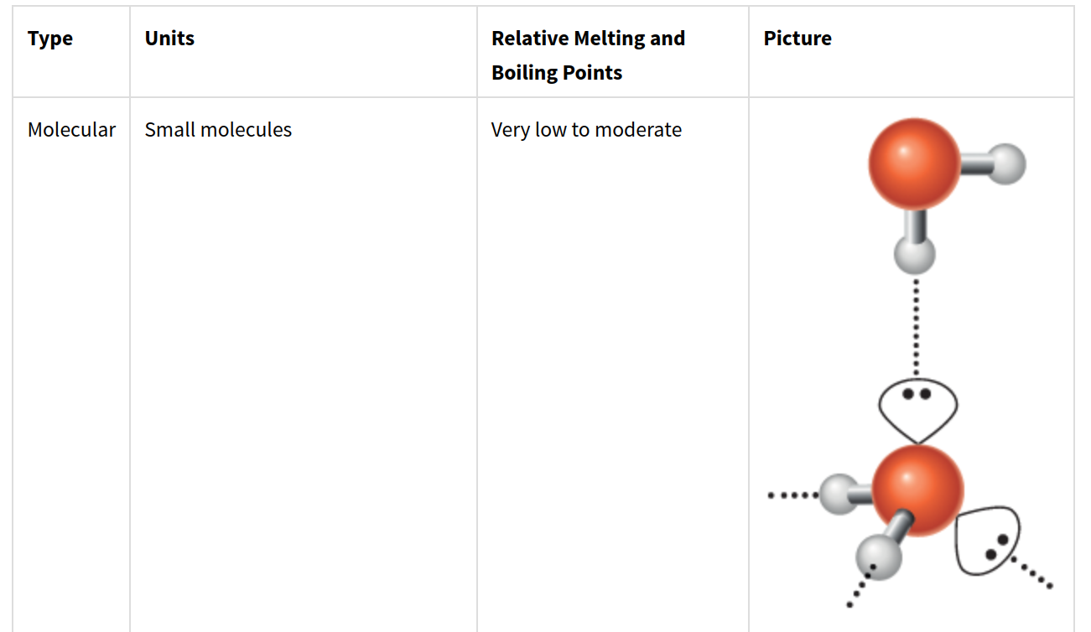
Crystalline solids: types

Slide 28
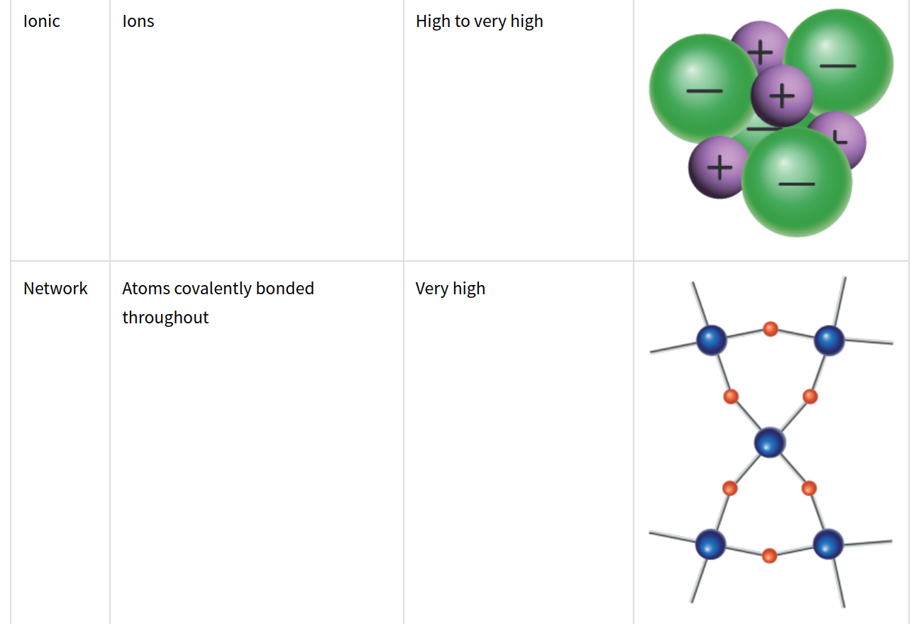
Crystalline solids: types

Slide 29
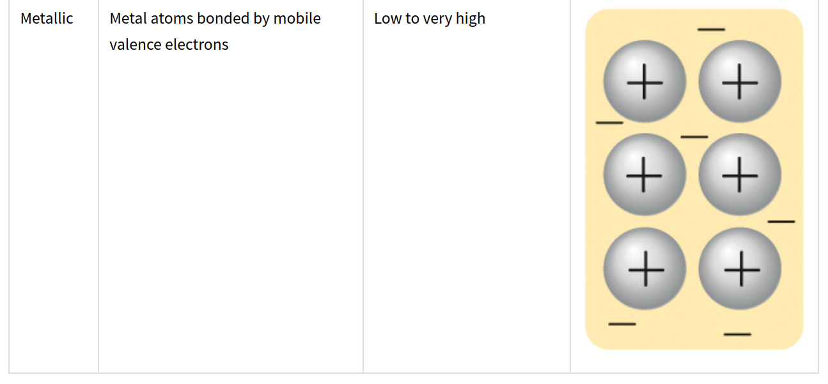
Crystalline solids: types

Slide 30
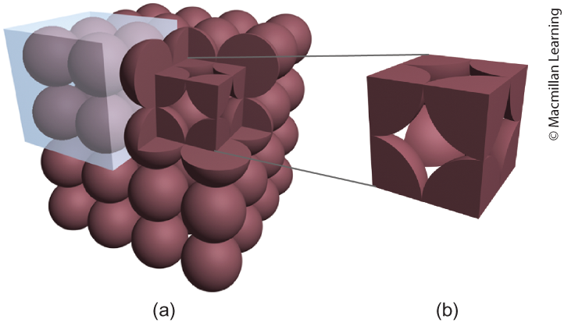
Crystals are highly organized
Many different crystal structures of repeating unit cells within a bulk
Example below shows simple cubic – atoms on the corners

Slide 31
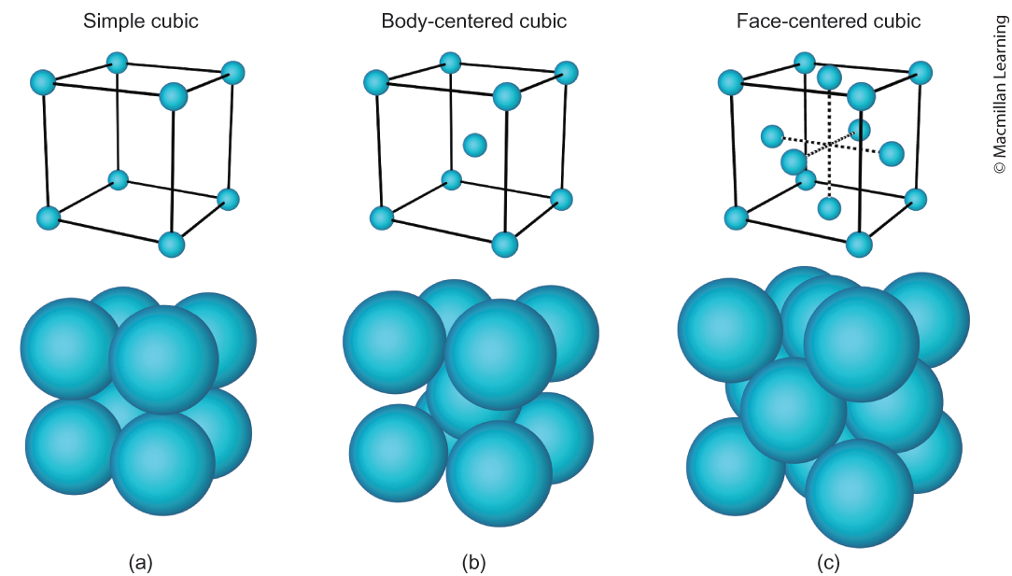
Types of unit cells

Slide 32
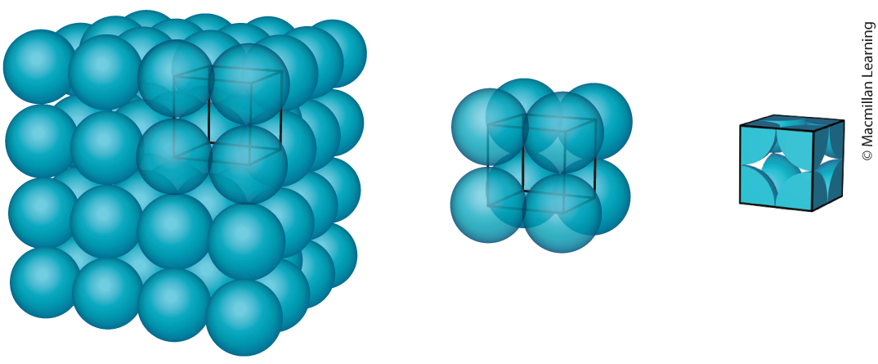
Simple cubic
Each corner consist of 1/8 of an atom
Each simple cubic unit cell has 1 atom
The radius (r) is simply 1/2 length of the cube (L) or lattice parameter

Slide 33
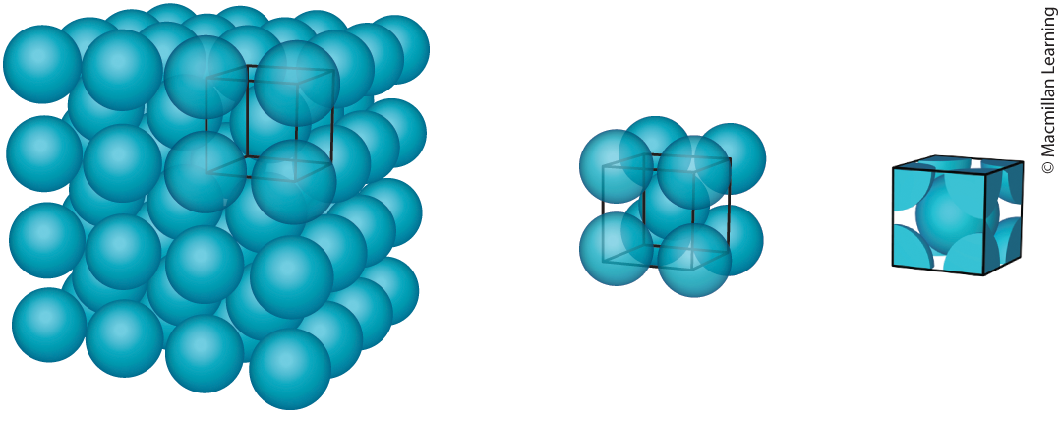
Body-centered cubic (BCC)
Each corner 1/8 of an atom and the center contains a whole atom
There are 2 atoms in body-centered cubic
Radius r = √3 L/4

Slide 34
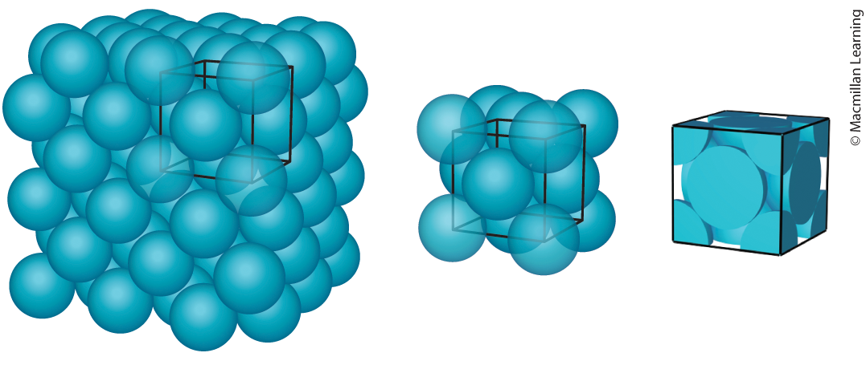
face-centered cubic (fCC)
Each corner 1/8 of an atom and the face contains 1/2 of an atom
There are 4 atoms in face-centered cubic
Radius r = √2 L/4

Slide 35
Outline
Announcements
Highlights prior lecture:
Intermolecular Forces – Connection to Real World
Phase Changes and Heating Curves
Vapor Pressure, Viscosity, Freezing/Boiling Point, and Surface Tension
Summary of the Research Article
Ch. 12: Liquids and Solids
Phase Diagrams
Types of Solids
Ch 13: Solutions
Concentration Units – Mass Percent, Mole Fraction, and Molality
Colligative properties

Slide 36
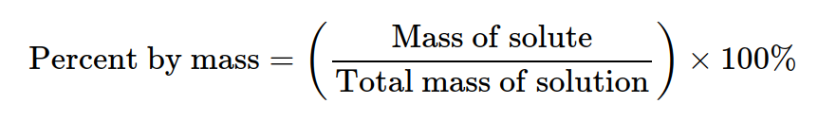
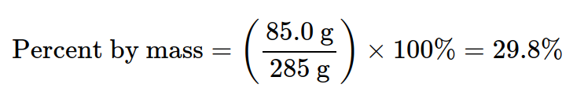
Concentration units
Recall molarity (mols of solute/L of solution) - Pay attention to units!
Mass percent (%)
Example: What is the mass percent of 245g solution that contains 85.0 g solute?

Slide 37
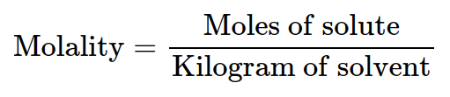
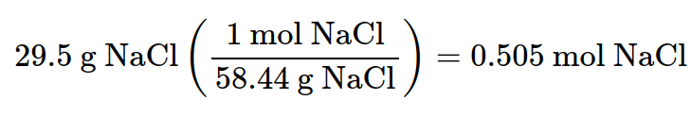
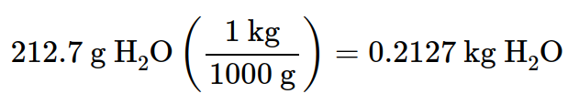
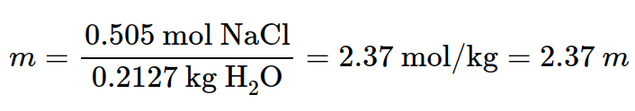
Concentration units
Recall molarity (mols of solute/L of solution) - Pay attention to units!
Molality
Example: Calculate molality of solution by dissolving 29.5g NaCl in 212.7g of water.

Slide 38
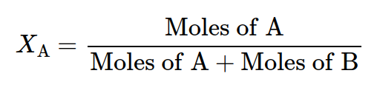
Concentration units
Recall molarity (mols of solute/L of solution) - Pay attention to units!
Mole fraction (unitless)

Slide 39
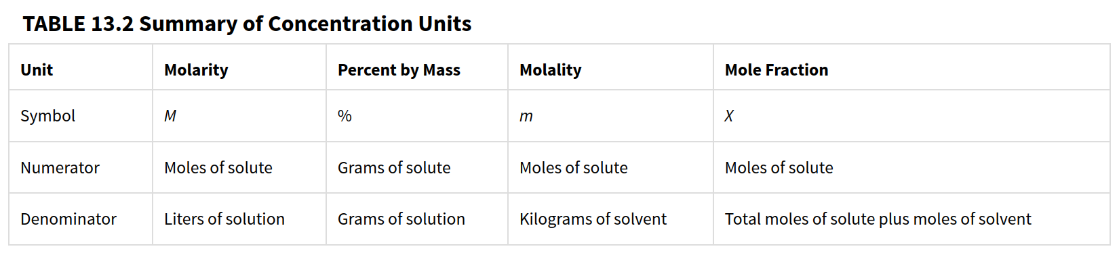
Concentration units – converting between units

Slide 40
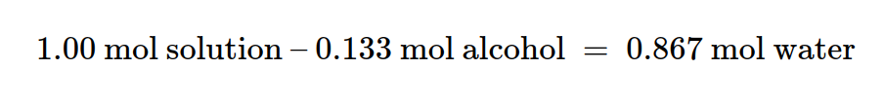
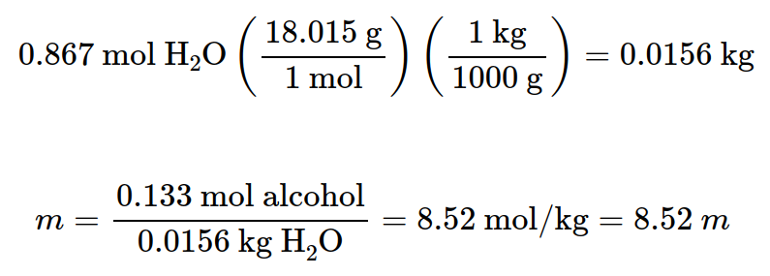
Example: converting between Concentration units
Calculate the molality of a solution of methyl alcohol, CH3OH, in water which the alcohol has a mole fraction of 0.133.

Slide 41
Outline
Announcements
Highlights prior lecture:
Intermolecular Forces – Connection to Real World
Phase Changes and Heating Curves
Vapor Pressure, Viscosity, Freezing/Boiling Point, and Surface Tension
Summary of the Research Article
Ch. 12: Liquids and Solids
Phase Diagrams
Types of Solids
Ch 13: Solutions
Concentration Units – Mass Percent, Mole Fraction, and Molality
Colligative properties

Slide 42

Colligative properties
Colligative properties – depends on the concentration of solute particles in solution and not the identity of the solute
Four known properties – vapor-pressure lowering, boiling point elevation, freezing point depression, and osmotic pressure

Slide 43
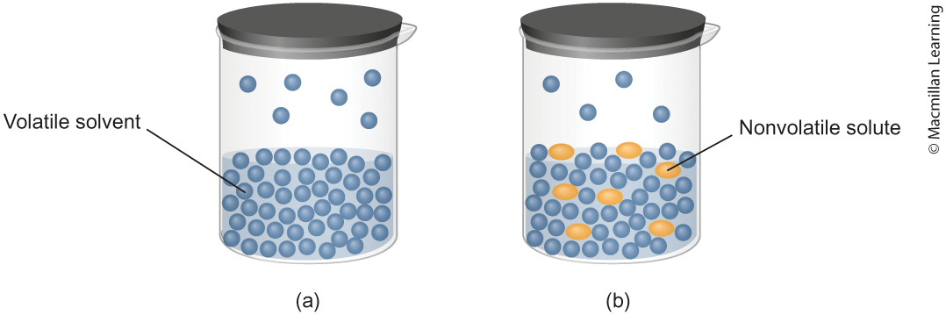
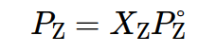
Vapor pressure lowering – Raoult's law
Like the pasta example, the nonvolatile solute prevents the volatile solvent from going into the gas phase
Raoult's Law – assumes ideal solution (interactions are equal), the vapor pressure (P_{z}) is the mole fraction (X_{z}) multipled by the vapor pressure pure solvent (P_{z}°)

Slide 44
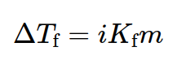
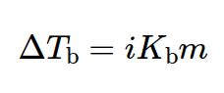
Boiling point elevation and freezing point depression
Formula to compute boiling point elevation (ΔT_{b}) and freezing point depression (ΔT_{f})
i is the van't Hoff factor and corresponds to how many ions in the solutions
m is the molality
K_{f} and K_{b} are freezing point and boiling point constants, respectively

Slide 45
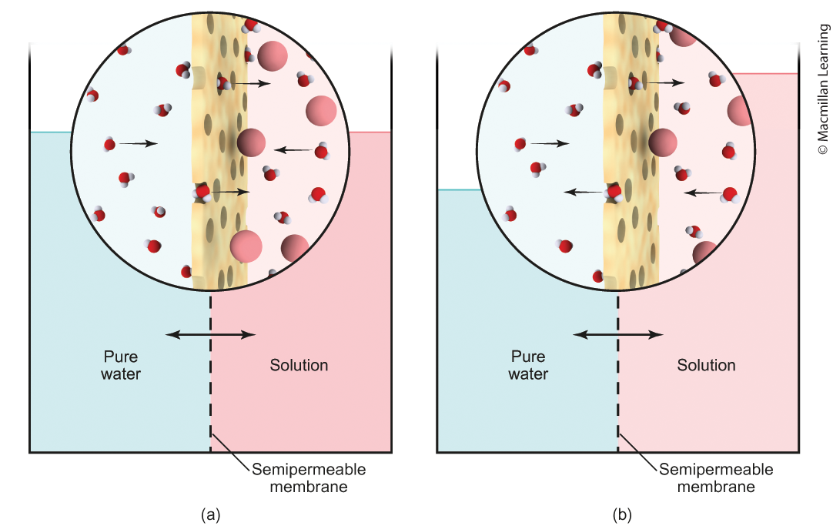
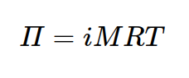
Osmotic pressure
Osmosis – diffusion of water via semipermeable membrane (only allows water to pass through)
Π is the osmotic pressure
i is the van't Hoff factor
R is the gas constant
T is the temperature
M is the concentration

